Slide 1

PENRHYS
Phase 1A planning consultation:
A quick guide

Slide 2
INTRODUCTION
Good news for Penrhys
Trivallis has taken an important step towards re-developing Penrhys. It has started the official planning process for Phase 1A with Rhondda Cynon Taf Council. This is called the pre-application consultation. This is an important part of the plan to make Penrhys better for the future.
What is a Pre-Application Consultation?
A pre-application consultation - also called a PAC - is a way for you to see the building plans and share your thoughts before they’re approved. It’s part of the process to get planning permission.
Why is it important?
It gives local people a chance to speak up officially. You can say if you like or don’t like the plan. You can share good ideas or worries about how it might affect you.
What happens?
We share our detailed plans. This includes maps, drawings, and diagrams of Phase 1A.
You can look at the plans and comment on them.
We will look at all the comments. We will take them on board and see what changes we can make before sending off the final planning application for Phase 1A.
How can you take part?
This booklet is a short version of the planning documents for the PAC. Read it to find out more about the plans.
You can see the full plans online at
  https://theurbanists.net/planning-application/penrhys-phase-1a
You can come to a meeting on Tuesday 23 September to ask questions about the plans.
You can make comments on the plans by emailing planning@theurbanists.net.
Important dates
The consultation starts on Wednesday 10 September 2025 and ends on Wednesday 8 October 2025.
Find out more about the plans on Tuesday 23 September, 1.00pm at Llanfair Church, and 6.00pm at the Rhondda Golf Club.
2

Slide 3
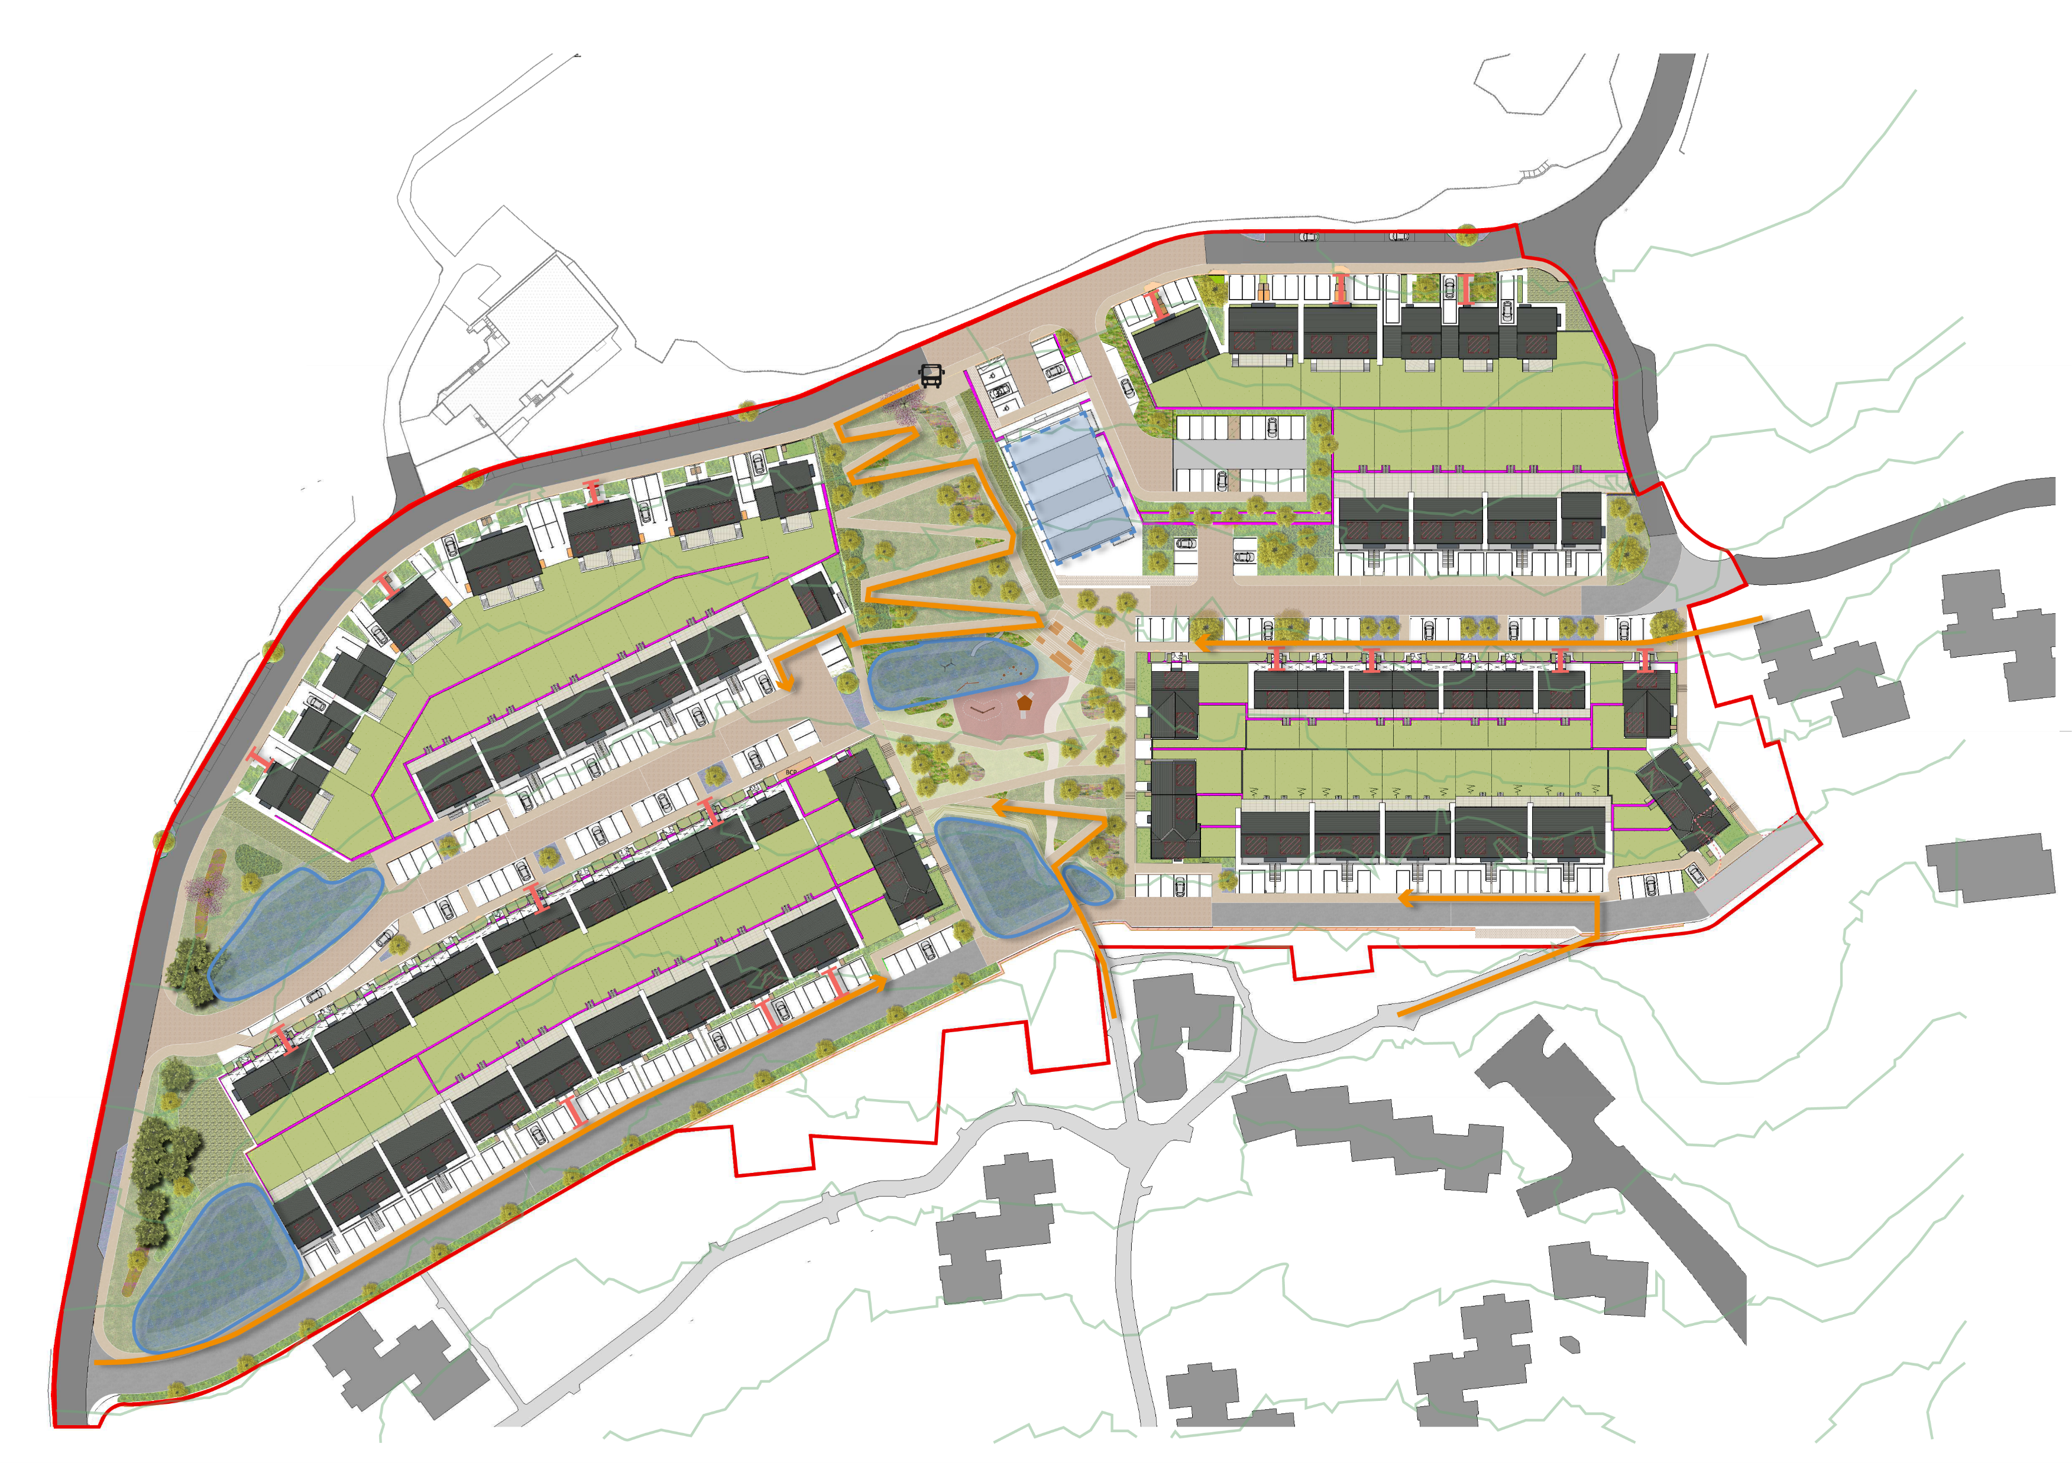
PHASE 1A
Phase 1A Site plan
Phase 1A is the first part of the new development to be built. It includes 121 new homes. The homes all face onto streets or green spaces. Each house has at least one parking space and a garden. Each flat has a parking space and a private balcony or terrace. Some houses have garages, and some don’t.
On this plan of Phase 1A, you can see where the new homes will be. The yellow lines show the footpaths across Phase 1A joining up with the existing site.
3

Slide 4
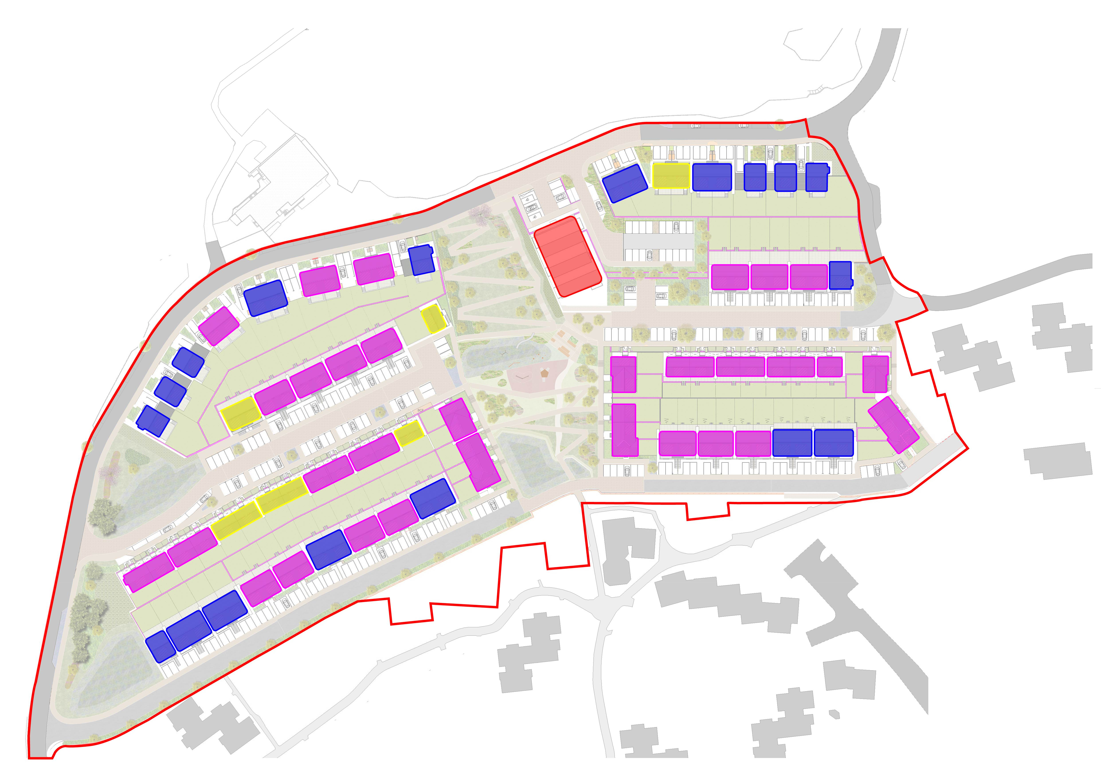

Phase 1A house types
These are the houses which will be built in Phase 1A.
Size | Type | Number of social homes | Number of private homes | Total
1 Bedroom / 2 People | Flat | 10 | 0 | 10
1 Bedroom / 2 People (Accessible) | Flat | 3 | 0 | 3
2 Bedrooms / 3 People | Flat | 3 | 0 | 3
2 Bedrooms / 3 People (Level Access) | Flat | 4 | 0 | 4
2 Bedrooms / 4 People | House | 8 | 0 | 8
3 Bedrooms / 4 People | House | 0 | 14 | 14
3 Bedrooms / 5 People | House | 16 | 36 | 52
4 Bedrooms / 6 People | House | 6 | 12 | 18
4 Bedrooms / 7 People | House | 0 | 9 | 9
Totals |  | 50 | 71 | 121
On this plan you can see how many bedrooms each home will have.
2 bedrooms
3 bedrooms
4 bedrooms
Flats
4

Slide 5
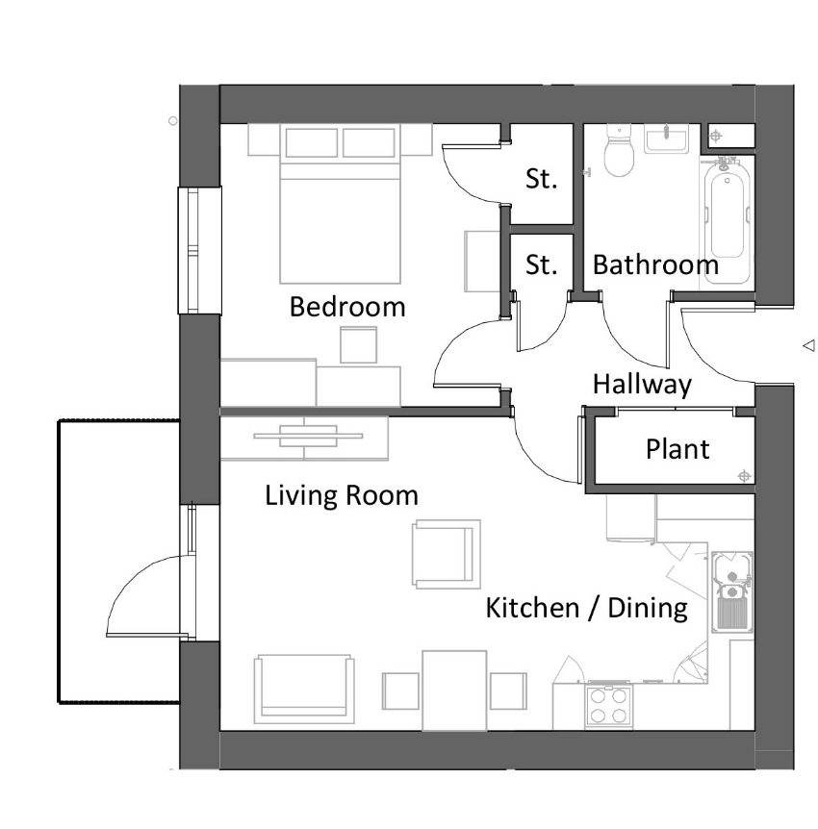
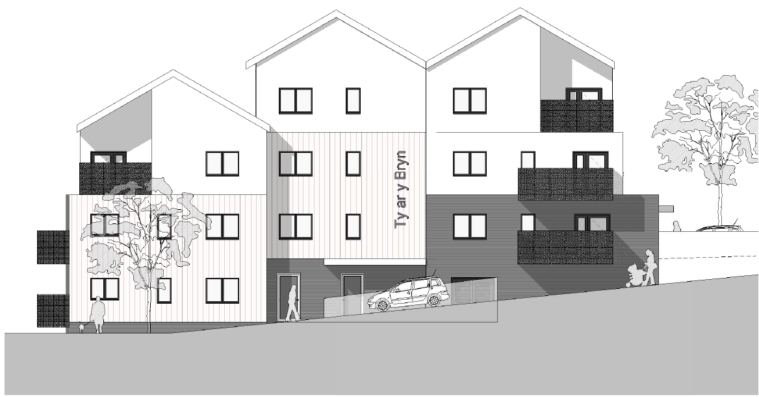
Phase 1A floor plans
We are building 18 different kinds of homes in Phase 1A. Some are flats and some are houses.
Here are simple plans and drawings for 3 types of homes in Phase 1A. You can see more plans in the planning documents.
1 bedroom / 2 person flat
This flat has one big bedroom for two people. There is a bathroom. The living room, kitchen, and dining area are all in one large open space. There is a door in the living room which will open on to a balcony.
This is what the flats will look like from the side.
5

Slide 6
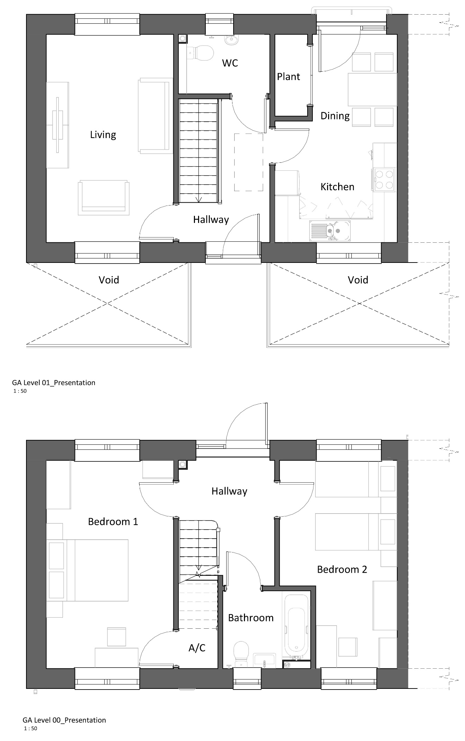
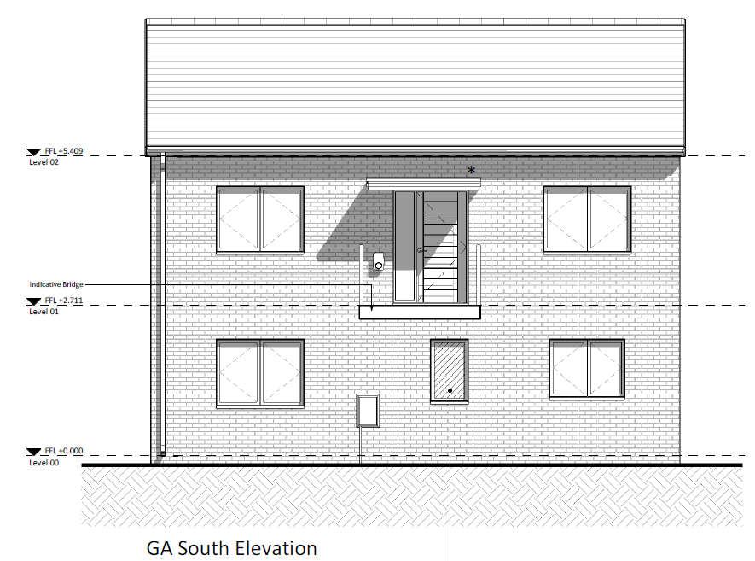
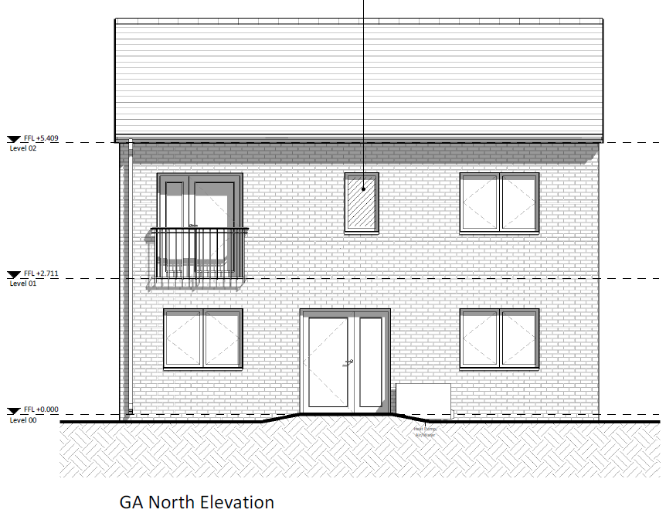
2 bedroom / 4 person house
You enter this house on the upstairs level. There will be a kitchen and a place to eat. A full-length door with a juliette balcony will overlook the Valley. There will be a small toilet near the hallway. On the other side of the hallway, there will be a living room. A small room called the plant room will hold the heating equipment. Stairs will lead downstairs to the bedrooms.
Downstairs, there are two bedrooms where four people can sleep. There is a bathroom for the whole family and a small airing cupboard for storing clothes. A door at the back of the house opens into the garden.
The view of the front with the
front door upstairs, facing uphill.
The view of the back with the door out to the back garden, facing downhill.
6

Slide 7
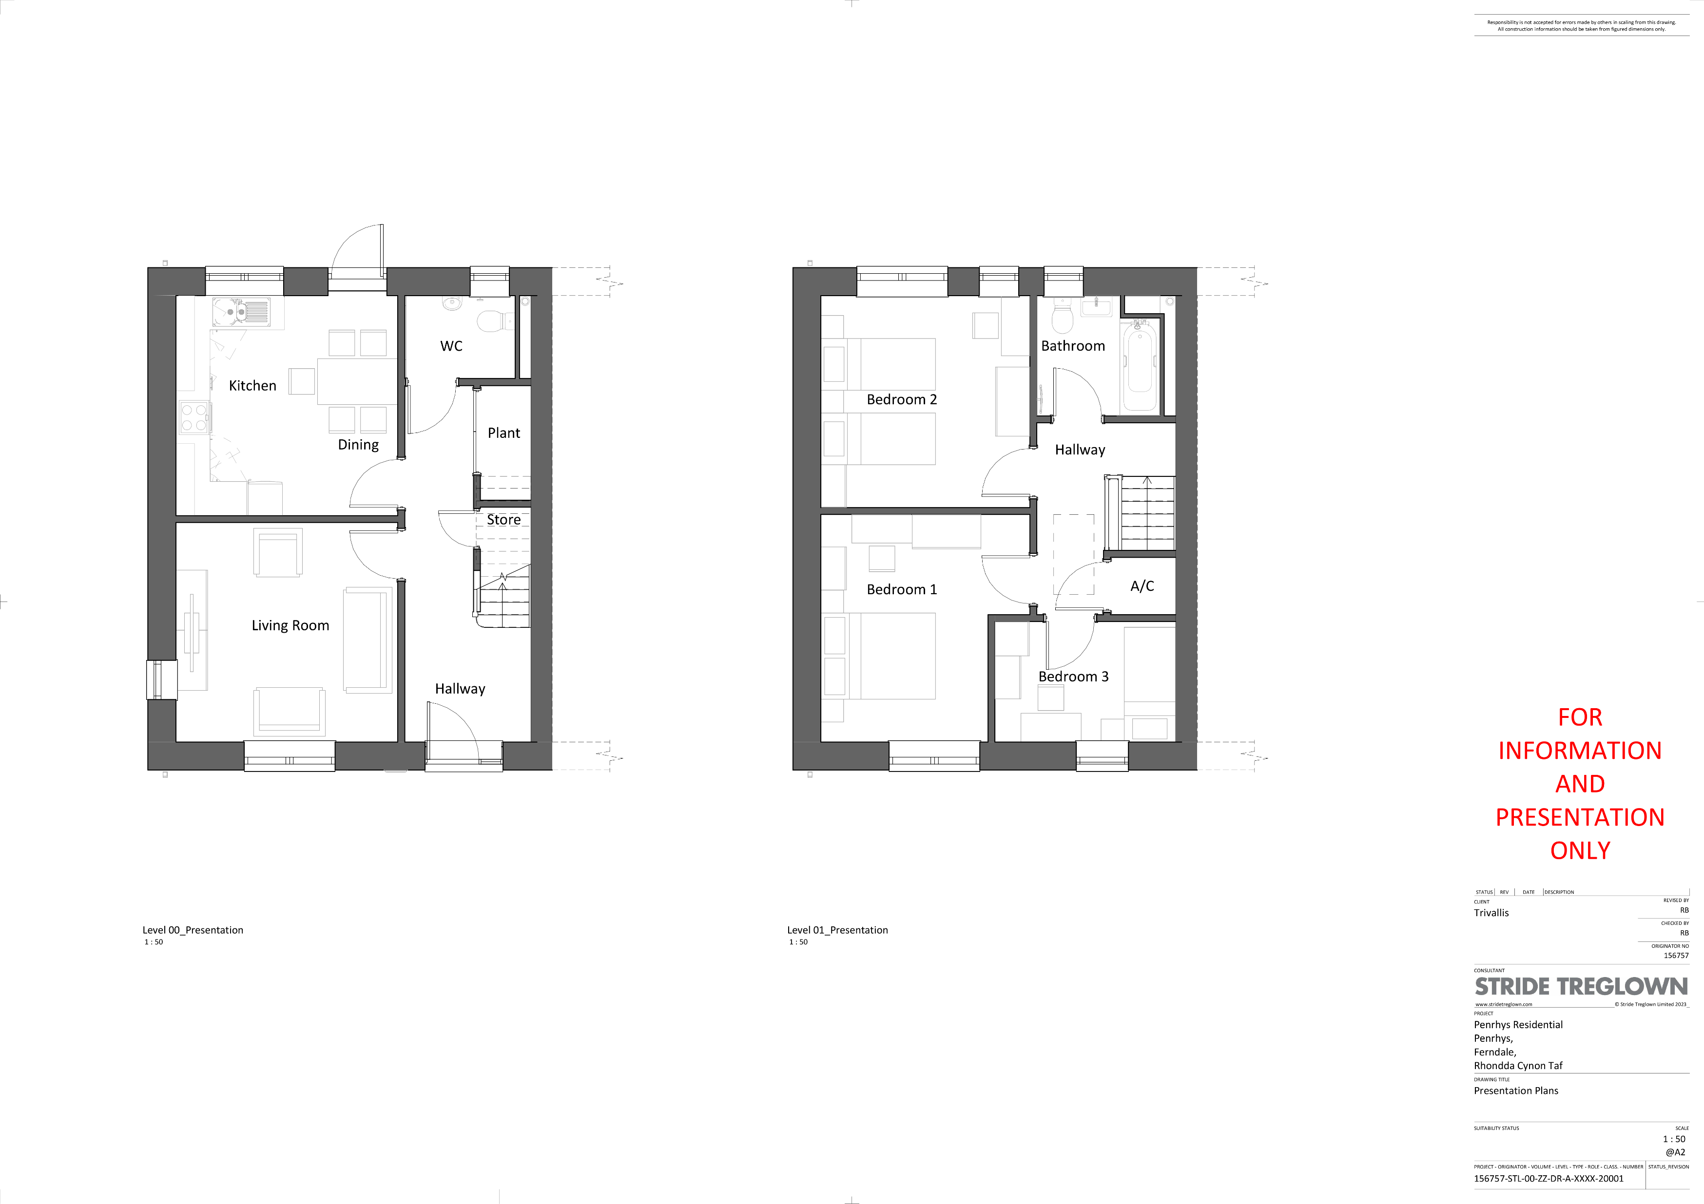
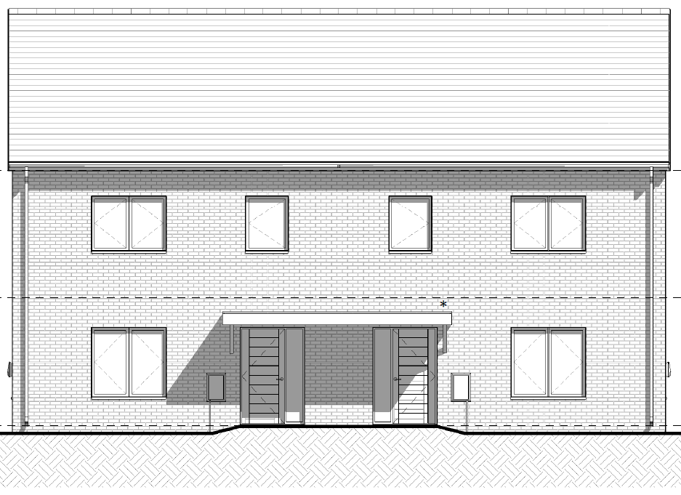
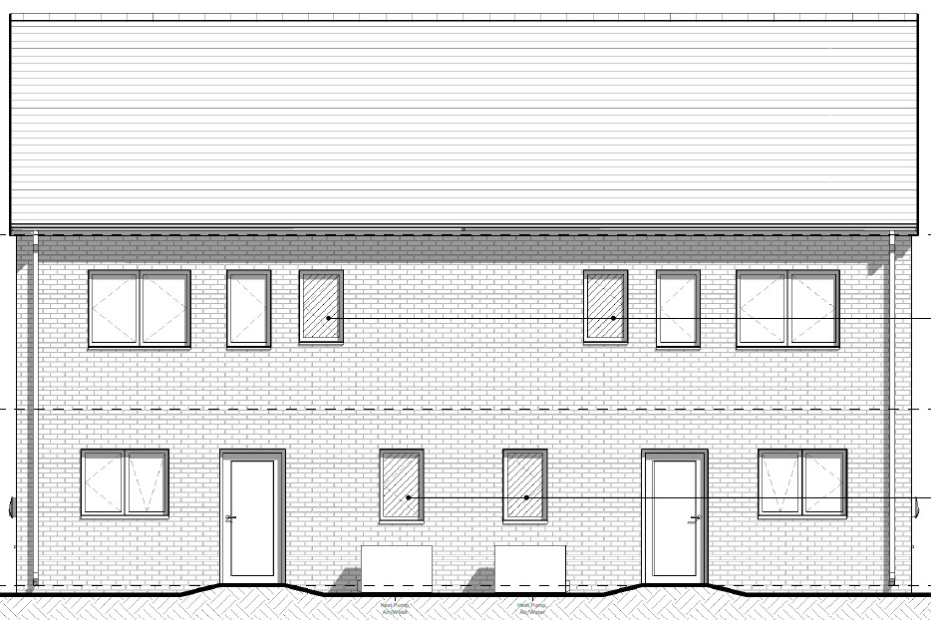
3 bedroom / 5 person house
This house is joined to another house on one side (semi-detached). At the front, there is a living room. At the back, there is a kitchen and a place to eat. There is a small toilet at the back. Under the stairs, there is a small cupboard called the plant room that holds the heating equipment.
Upstairs, there are 3 bedrooms where 5 people can sleep – 2 larger bedrooms and 1 smaller bedroom. There is a bathroom for the whole family and a small airing cupboard for storing clean clothes.
The view of the house fronts with the front doors.
The view of the back with the doors out to the back gardens.
7

Slide 8
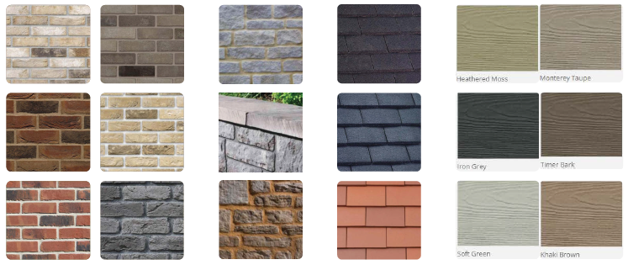
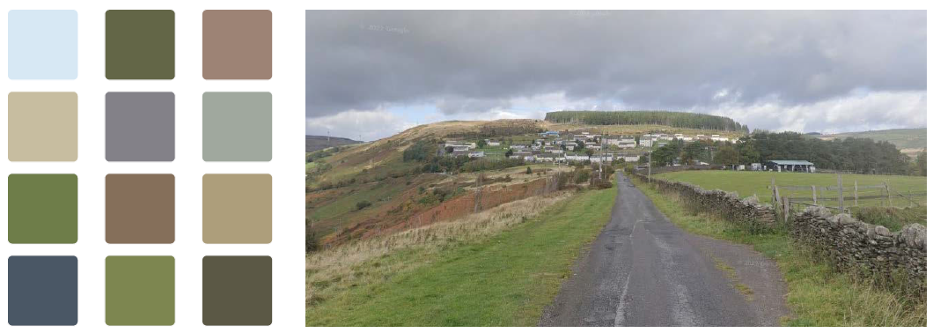
Different types of homes
Some of the homes in Phase 1A will be flats. Some houses will have two floors, and some will have three.
Upside down homes
Some homes will be ‘upside down’. You will enter on the top floor. This means some of the bedrooms will be downstairs, and the living room, kitchen, and dining room will be upstairs. This is because the land is very steep, but it means you’ll get the best views from your living room.
Beautiful views
The development will have lovely views over the Valleys below.
Strong homes that last
The new homes will be built to handle tough weather. They will be covered in brick or cladding to make them strong and long-lasting.
Natural colours
In Phase 1A we’re using colours that match the land around Penrhys, like soft brown, cream, heather and green. These colours help the homes blend in with nature and give the area a peaceful feel.
8

Slide 9
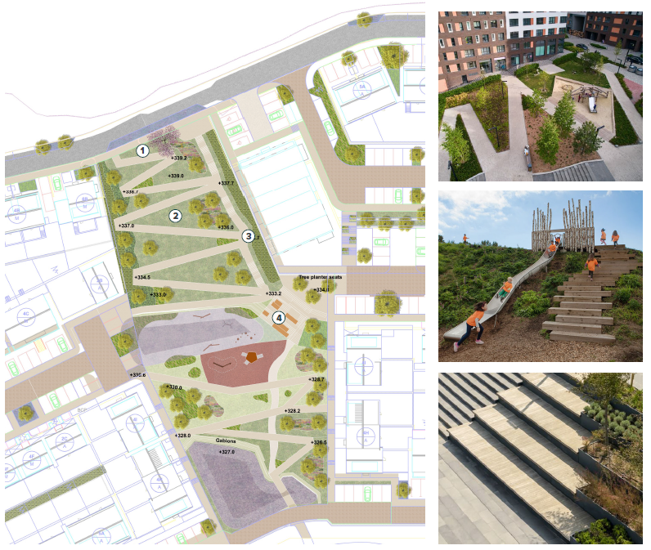
Roads, parking and bins in Phase 1A
The roads have been planned to be safe and easy to use. Phase 1A will improve the ring road. It will be narrower with planting and features to slow down the traffic. Smaller streets will lead off this to the homes. Most of these streets won’t go anywhere else, so they’ll be quiet and safe. These quiet streets will be good for walking, cycling, and playing. Slower traffic will help keep everyone safe.
There will be proper crossings on the main road so people can cross it safely.
Parking spaces will be right outside each home, so you won’t have to walk far to your car. Some extra parking will be on the street.
Roads will be wide enough for bin lorries or two cars to pass each other. You won’t have to take your bins far – rubbish will be collected close to your home. There will be turning spaces for large vehicles like bin lorries.
Protecting nature and wildlife
We know that wildlife and nature are important to local people. Ecologists have done surveys to check how bats, birds, reptiles, plants and other wildlife might be affected by the Phase 1A development. Experts have made plans to protect wildlife.
Phase 1A greenway
A new green path will be built for walking through Phase 1A. It will have ramps so everyone can use it easily. There will be places to play along the sides. Seats will be placed along the path, and some steps will be made for people to sit and meet.
We will keep some of the trees that are in this space now and add in other trees. Wild edges will provide space for nature.
9

Slide 10
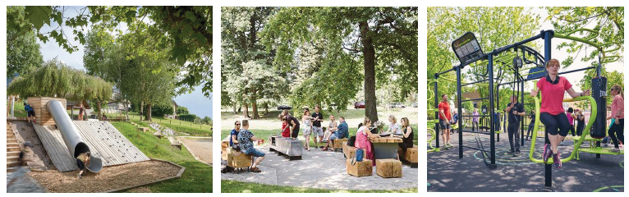
IDEAS FOR THE REST OF THE DEVELOPMENT
Most of this booklet is about Phase 1A. Soon we will ask for Phase 1A planning permission. We will ask for permission for the rest of the site later. We will keep talking to local people about future plans. Here are some ideas we’ve already discussed.
Working with local people
People living locally have helped shape the plans for Phase 1A and the other phases of the development. Monthly meetings have let the design team hear their ideas. They are helping decide where parks and green spaces go, and what materials to use. The village’s history and special meaning will be part of the plans, with places to share stories.
Building on the good things
Penrhys has a strong community and beautiful views. The new development keeps the good things – like community buildings, the landscape, and the history. It will fix the problems, like poor housing and lack of facilities. The village will feel more connected and part of the natural surroundings.
Better homes and more services
Penrhys needs better homes and roads. More homes will bring more people, which means more shops, jobs, and things to do. More children at the school will help keep it open. People won’t need to travel far for everyday needs.
A mix of things in the village
Future phases include more homes, shops, community spaces, and places for fun and culture. The mix is still being worked on and may change as plans develop.
New places to meet and enjoy
New public spaces are coming in later phases. Local people will help choose what play areas and green spaces they want. There will be trees, plants, and better drainage to stop flooding. Parc Calon, a big green area, will be in the middle near a church and community hub. These places will be safe and friendly for meeting, talking, and playing.
10

Slide 11
Making it easier to get around
Local people have asked for safe paths, and places to sit and rest. The new village will have clear, easy-to-use paths for walking and cycling. We’ll improve access for everyone, including people with mobility needs. Most streets will be quiet, with fewer cars and slower traffic. There will be places to rest and fewer steps. More homes mean more people using buses, so Trivallis is looking at better bus links, including a shuttle to Ystrad Rhondda train station.
Celebrating nature and wildlife
In future phases, there will be green spaces to support nature and wildlife. We’ll use plants like those found nearby and create safe places for birds, insects, and animals. Trees will be replanted, and nature areas will be improved. Some rare species may be moved to new homes. Experts are helping us protect the land and make sure nature can grow while we build new homes.
HOW CAN YOU COMMENT ON THESE PLANS?
This booklet is a short summary of the planning documents. You can see the full plans online at https://theurbanists.net/planning-application/penrhys-phase-1a
On Tuesday 23 September, Trivallis is holding meetings where you can ask questions about the plans. The meetings are 1.00pm in Llanfair Church and 6.00pm at Rhondda Golf Club.
You can make comments on the plans by emailing planning@theurbanists.net before Wednesday 8 October.
Citizens Advice RCT will be supporting people living in Penrhys to take part in the consultation. They can give clear and fair advice to help you understand the planning documents and share your views in the right way.
11

Slide 12
Use this space to write down any questions or comments you have about the plans we’ve shared in this booklet:
12

